Slide 1
Softwares Installation
CS307
by wwy

Slide 2
PostgreSQL
DataGrip

Slide 3
What is Postgres
ORDBMS
Object-relational
database
management system

Slide 4
Postgres(SQL)
SQL
Structured Query Language
https://www.postgresql.org/docs/13/sql.html

Slide 5
Why choose Postgres
The World's Most Advanced Open Source Relational Database
Free
Stability
Widely used

Slide 6
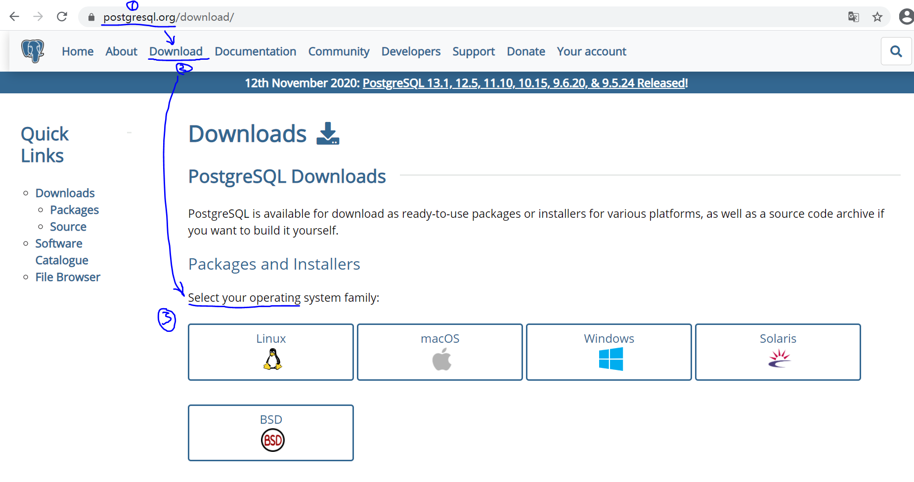
How to download Postgres
https://www.postgresql.org/

Slide 7
How to install Postgres
Install on Windows
Install on Linux
Install on Mac
Tutorial by Zhu Yueming

Slide 8
Why DataGrip
Cross-Platform
JetBrain:https://www.jetbrains.com/zh-cn/community/education/#students
Copyright
Intergreated Development Environment

Slide 9
How to download&install DataGrip
Refer to DataGrip Official Web
Read System requirment and Installation Instructions first

Slide 10
How to use DataGrip
Brief direction in Part IV of Tutorial by Zhu Yueming

Slide 11
Conection Modes
client
client
IDE
Program
DBMS
IP
Port
User
Password
Database
Driver
client
service
Script

Slide 12
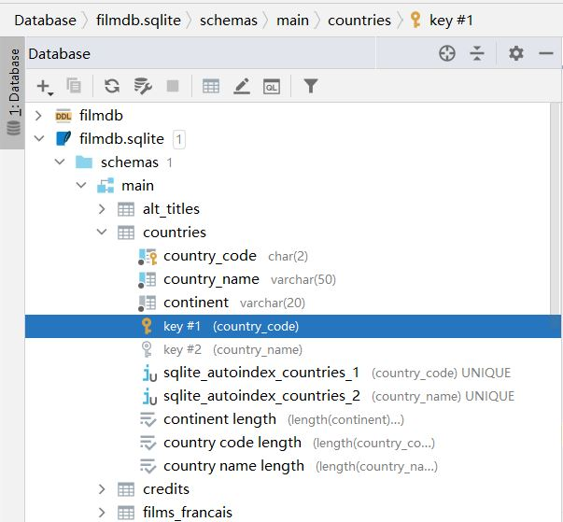
Postgres Structure
Database
Schema
View
Tables
Datas
Logic

